Slide 1
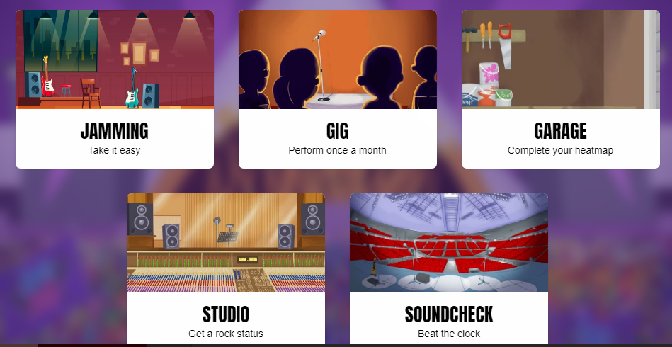
Jamming
This is used for practising at leisure!
Our only timer-free game, Jamming gives players the choice over the tables they practise and whether to include multiplication, division or both. It's perfect for building up confidence on the tables of your choice, at your own pace.
Player chooses which table(s) to practise
4 coins per correct answer for multiplication-only or division-only; 8 coins for multiplication and division questions together 10, 20 or 30 questions to answer
Gig
This is used as an assessment tool for teachers!
Gigs give pupils and their teachers a way to check overall performance each month. It's a good idea for pupils to play a Gig early in their TTRS journey so that you have a baseline. Once played, it becomes unavailable until the 1st of the next month.
100 questions starting with the 10 times table, then the 2s, 5s, 3s, 4s, 6s, 7s, 8s, 9s, 11s and 12s.
5 minute time limit
10 coins per correct answer
Garage
This is where we want children to be playing the most!
The Garage is the best place for mastering individual tables as it's highly rewarding (10 coins per correct answer) and very carefully personalises the questions for each player in every game. Teachers can turn certain tables off if required but it's rarely recommended. Our algorithm adapts the questions every game for every player
10 coins per correct answer
1, 2 or 3 minute games
Studio
This is where they set their Rock Status!
The Studio is the place to go to set a Studio Speed and get a Rock Status. The Studio Speed is the average of their most recent 10 Studio games (so until they've played 10 times there will be no Studio Speed).
All tables up to 12×12
1 coin per correct answer
1 minute games
Soundcheck
This is where we want children to practise for their multiplication check!
When pupils play Soundcheck, they are asked 25 questions, each with a 6-second time limit. The questions are multiplication only and evenly weighted in terms of difficulty each time they play - exactly the same as the UK government's 'Multiplication Tables Check'.
All tables up to 12×12
5 coins per correct answer
25 questions, 6-second time limit for each question

Slide 2
Festival - World
The Festival is for those children who are ready to take on other students from all around the world, answering any question up to 12 × 12. Each multiplayer Festival game is one minute long and students earn 1 coin per correct answer.
All tables up to 12×12
1 minute games
Rock Slam – 1:1 challenge with anyone in school
A Rock Slam allows a student to challenge someone from their class, year group or school (either a pupil or a teacher), setting a time for the challengee to beat. When the challengee logs in, they'll be able to play against the challenger's 'ghost' in a head-to-head Rock Slam!
1 vs 1
All tables up to 12×12
1 coin per correct answer
1 minute games
They don't need to be online at the same time.
Multiplayer Games
Arena - Class
The Arena is a multiplayer game where students can compete live against other children in their class. Like Garage, specific tables can be turned off by the teacher on the Set Tables page but it's not recommended.
Our algorithm adapts the questions every game for every player
1 coin per correct answer
1 minute games

